Slide 1

Professional Education March 2022 LET Questions

Slide 2

1. What is the proper characterization for the PowerPoint presentation to deliver a lesson?
a. academics
b. technology
c. machinery
d. culture

Slide 3
Used thoughtfully, PowerPoint can enhance your teaching sessions by providing a roadmap, reinforcing what you say and allowing you to use graphics and other multimedia to clarify understanding and to support different learning styles.

Slide 4
2. Which type of test can show the student’s synthesizing skills?
a. performance test
b. diagnostic test
c. multiple choice test
d. completion test

Slide 5
Performance assessment - this assessment measures how well students apply their knowledge, skills, and abilities to authentic problems. The key feature is that it requires the student to produce something, such as a report, experiment, or performance, which is scored against specific criteria.

Slide 6
3. What are characteristics of good management plan?
a. It is clear and simple.
b. It is prepared by students.
c. It is approved by parents.
d. It comes from the principal.

Slide 7
A good management plan helps you accomplish your goals in a number of ways: It clarifies the roles and responsibilities of everyone in the organization so that everyone knows what she and everyone else is supposed to do. Staff members know who they need to go to for information, consultation, supervision, etc.

Slide 8
4. Given the oldest historical understanding of a teacher which of the following is closest to the idea of the first teachers who were parents or elders transmitting norms, crafts and beliefs to the young?
a. School teacher
b. Master
c. Guardians
d. Coach

Slide 9
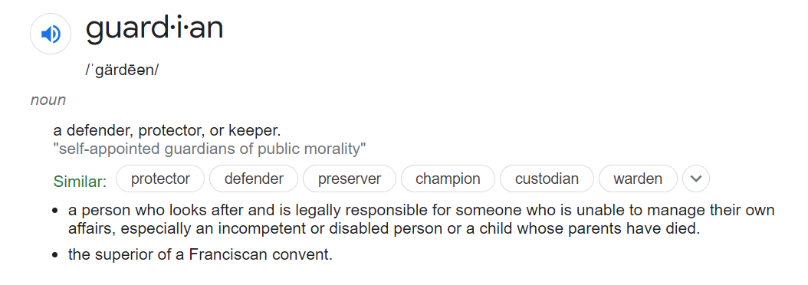

Slide 10
5. On periods of development, what feature characterizes the child in early childhood?
a. high level of cognition
b. independence
c. readiness for schooling
d. maturity

Slide 11
The early signs of cognitive ability and maturity, children's work-related and learning-related social skills and self-regulatory skills have been identified as factors that contribute to and define “school readiness”.

Slide 12
6. What characteristics show that a teacher has empathy towards learners?
a. strength and conviction
b. caring and love
c. loyalty and affinity
d. discipline and fortitude

Slide 13
The term “empathy” is used to describe a wide range of experiences. Emotion researchers generally define empathy as the ability to sense other people's emotions, coupled with the ability to imagine what someone else might be thinking or feeling.

Slide 14
7. Which of the following is a routine procedure in class management?
a. experiment
b. role-play
c. roll-call
d. research

Slide 15
Routines are an important way to establish norms, set expectations, and otherwise build positive relationships in the classroom environment (and the workplace). They help everyone involved be on the same page.

Slide 16
8. There are varied aspects to professionalism among teachers, but which aspect is their inner deals, commitment and dedication as teachers?
a. ethical aspect
b. social aspect
c. cultural aspect
d. work aspect

Slide 17
Ethics is connected to cultural meaning and social power to provide the philosophical base for justice, proper use of power and authority, and right relationships. As a whole, decisions and their rightness, consequences and context are all ethically very important in the development of sustainable society.

Slide 18
9. What assessment provides a total view of a student’s performance?
a. summative
b. developmental
c. placement
d. formative

Slide 19
Summative assessments are used to evaluate student learning, skill acquisition, and academic achievement at the conclusion of a defined instructional period — typically at the end of a project, unit, course, semester, program, or school year.

Slide 20
10. How is periodic reporting of student grades useful?
a. as an obligation
b. as way to please parents
c. as way to win support for the school
d. as feedback

Slide 21
Feedback is any response regarding a student's performance or behavior. It can be verbal, written or gestural. The purpose of feedback in the assessment and learning process is to improve a student's performance - not put a damper on it.

Slide 22
11. What activity of human intelligence attaches value or quantitative description to measuring results of learning activities?
a. analysis
b. critical thinking
c. assessment
d. understanding

Slide 23
In education, the term assessment refers to the wide variety of methods or tools that educators use to evaluate, measure, and document the academic readiness, learning progress, skill acquisition, or educational needs of students.

Slide 24
12. Rexor’s score is within 1 SD. To which of the following groups does he belong?
a. needs improvement
b. average
c. above average
d. below average

Slide 25
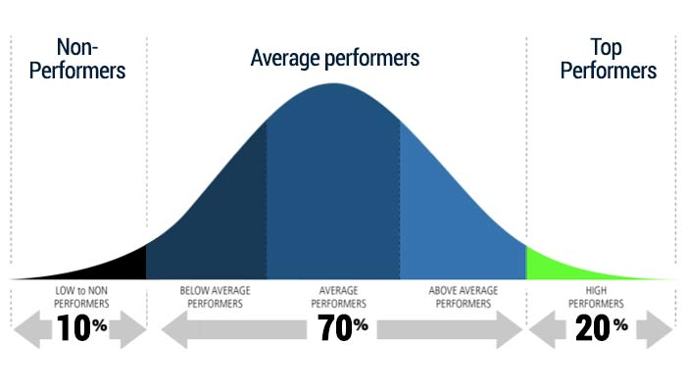

Slide 26
13. Which portfolio is most appropriate to show improvement in learning and transforming a student?
a. process portfolio
b. development portfolio
c. assessment portfolio
d. showcase portfolio

Slide 27
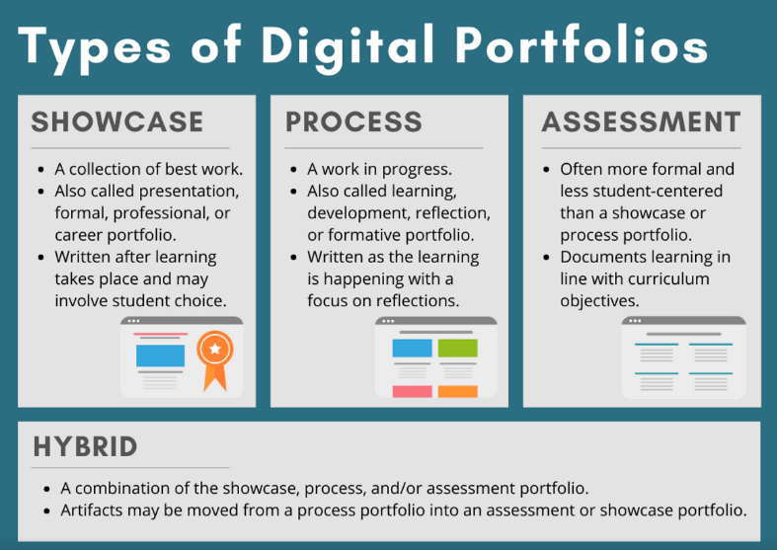

Slide 28
14. How are Massive Open Online Courses (MOOCs) delivered to learners of all kinds (students, retirees, those changing careers, etc.)?
a. through correspondence
b. through the internet
c. through classroom instruction
d. through field training

Slide 29
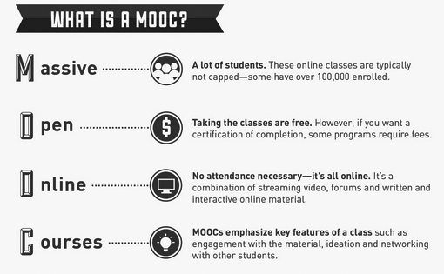

Slide 30
15. On cognitive principles in test construction, what ability is required to correctly answer filling the blanks questions?
a. analytical thinking
b. creative imagination
c. application process
d. memory recall

Slide 31
“Memory” is a single term that reflects a number of different abilities: holding information briefly while working with it (working memory), remembering episodes of one’s life (episodic memory), and our general knowledge of facts of the world (semantic memory), among other types. Remembering episodes involves three processes: encoding information (learning it, by perceiving it and relating it to past knowledge), storing it (maintaining it over time), and then retrieving it (accessing the information when needed).

Slide 32
16. Regardless of the transition period, how many credit units for CPD is required of professional teachers every three years for renewal of license?
a. 10 credit units
b. 15 credit units
c. 45 credit units
d. 30 credit units

Slide 33
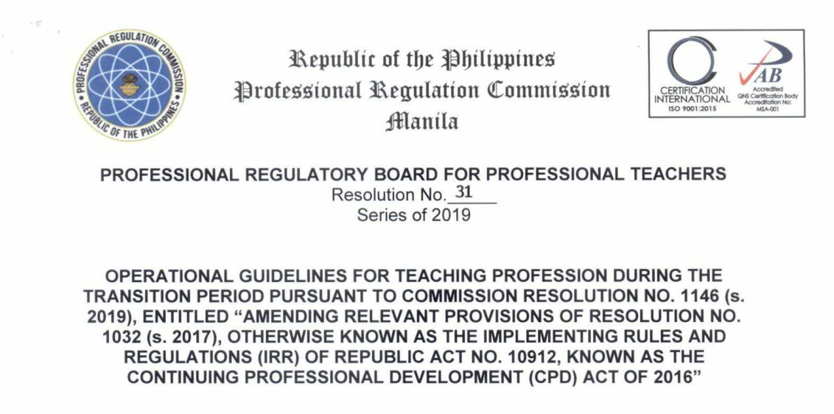
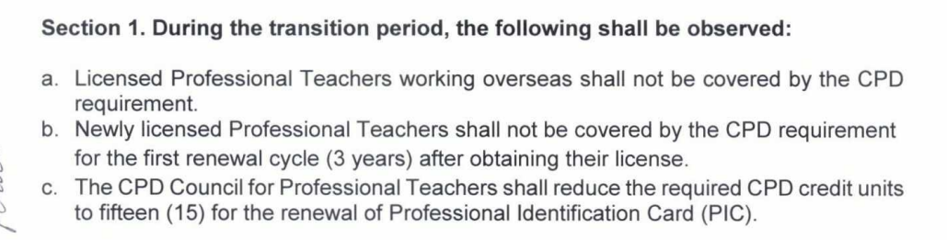

Slide 34
17. What can be the instructional value of a web application that provides fun and excitement to early learners like one designed along an amusement park ride?
a. it is high order learning
b. it is good for all grade levels
c. it gives sophistication in design
d. it is motivating

Slide 35
The social nature of Web applications have the potential to empower education. These applications provide a learning environment in which students can construct their learning, collaborate with others, generate ideas, edit and distribute their material, and more.

Slide 36
18. What kind of problems do action research address?
a. potential problems on school finance
b. cognitive problems on pedagogy
c. practical and resolvable problems
d. speculative problems on teaching

Slide 37
In schools, action research refers to a wide variety of evaluative, investigative, and analytical research methods designed to diagnose problems or weaknesses — whether organizational, academic, or instructional — and help educators develop practical solutions to address them quickly and efficiently.

Slide 38
19. On classroom activities, the following are appropriate for learners who have good spatial skills, but NOT to include:
a. community projects
b. concept maps
c. visual presentation
d. preparing graphs

Slide 39
Spatial intelligence is the concept of being able to successfully perceive and derive insight from visual data. This cognitive process is known as an aptitude for understanding visual information in the real and abstract word as well as an innate ability to envision information.

Slide 40
20. What is being asked of students in a task to determine elements and explain them in relation to other parts or the whole?
a. analysis
b. assessing
c. recall
d. understanding

Slide 41
Simply put, analysis means breaking down the content. According to the dictionary, analyzing means “examine, methodically and in detail, in order to explain and interpret it.” Therefore, in order to analyze information, our students must first be able to read and comprehend it.

Slide 42
21. On principles of teaching-and-learning, what do Cognitive theorists see as the way to develop learners?
a. learning by modelling of skills
b. learning by thinking
c. learning by perceiving the environment
d. learning by imitation of ideas

Slide 43
Cognitivism is a learning theory that focusses on how information is received, organized, stored and retrieved by the mind. It uses the mind as an information processer, like a computer. Therefore, cognitivism looks beyond observable behavior, viewing learning as internal mental processes.

Slide 44
22. In the K to 12 Basic Education Curriculum, science is formally taught from:
a. Grade 4 to Grade 12
b. Grade 1 to Grade 10
c. K to Grade 12
d. Grade 3 to Grade 12

Slide 45


Slide 46
23. You want to know who a good teacher is. In the Philippines which would you consult?
a. Philippine Professional Standards for Teachers
b. Professional Philippine Teacher Standards
c. National Competency-Based Teacher Standards
d. Professional Code of Ethics

Slide 47
The Philippine Professional Standards for Teachers defines teacher quality in the Philippines. The standards describe the expectations of teachers’ increasing levels of knowledge, practice and professional engagement. At the same time, the standards allow for teachers’ growing understanding, applied with increasing sophistication across a broader and more complex range of teaching/learning situations.

Slide 48
24. If I apply Vygotsky’s theory of learning, which will I do?
a. allow the child to choose his learning activity
b. establish classroom disciplining from the very start
c. assist the child where he needs assistance until he can be on his own
d. follow a logical arrangement of topics

Slide 49
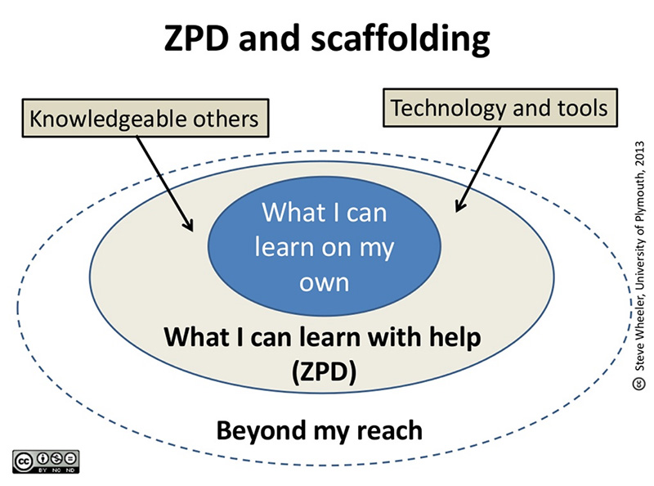

Slide 50
25. Due to the advent of COVID 19, which initiative is required for curriculum change?
a. curriculum implementation
b. curriculum evaluation
c. curriculum design
d. curriculum modification

Slide 51
Curricular accommodations or modifications are alterations to the curriculum to better suit the needs of students who have some level of disadvantage. Learn the different types of accommodations and modifications that allow teachers to adjust the curriculum to better educate their students.

Slide 52
26. In a lesson, when do teachers make ideas universally applicable to other ideas or situations?
a. summarization
b. generalization
c. comparison
d. abstraction

Slide 53
Herbartians believe that it is important to organize lessons based on students’ interests and their stages of development. The five steps of the Herbartian lesson plan are: preparation, presentation, comparison and abstraction, generalization or definition, and application. The preparation stage is used to review concepts with students and discuss how the material being presented relates to previous knowledge or interests they have. The presentation is specifically organized so that the material presented relates to previous knowledge or interests. Comparison of the material being presented, and material previously learned is done in the comparison and abstraction stage. A single definition expression the overall concept of the lesson is created in the generalization or definition stage. Application then allows students to apply that definition to outside experiences.

Slide 54
27. What is the philosophical basis for education in recent years of General Education subjects in career studies in College level?
a. utilitarianism
b. traditionalism
b. essentialism
c. perennialism

Slide 55
Essentialism and perennialism are two great educational philosophies. Essentialism is an educational philosophy that aims to ensure that students systematically and disciplinedly acquire a common core of knowledge. In contrast, perennialism is an educational philosophy that says that one should teach the things that are of eternal importance to all people everywhere.

Slide 56
28. As a teacher, how will you best understand the need to nourish the child along the axiom “Man does not live by bread alone”?
a. need to enforce discipline
b. need to teach human values
c. need to follow the syllabi
d. need to teach the 3Rs

Slide 57
The proverb man does not live by bread alone means that human beings need more than the simple necessities to keep them biologically alive, they need things that feed them mentally, spiritually, aesthetically, and they need things that give their lives meaning.

Slide 58
29. What does “grading on the curve” mean?
a. grading compared with achievement
b. normal scale of grades of students
c. achievement more important than grades
d. grading more important than achievement

Slide 59
Grading on a curve means adjusting student scores after an assignment. The idea of "the curve" goes back to a bell curve. In a typical class, professors can expect a majority of grades to fall near the class average, with a smaller number of A grades and failing grades

Slide 60
30. Which is the best class performance on a 100-item test?
a. mean is 80 and SD is 2
b. mean is 82 and SD is 10
c. mean is 90 and SD is 2
d. mean is 80 and SD is 12

Slide 61
The formula for calculating a z-score is is z = (x-μ)/σ, where x is the raw score, μ is the population mean, and σ is the population standard deviation. As the formula shows, the z-score is simply the raw score minus the population mean, divided by the population standard deviation.

Slide 62
31. Among varied tasks, how can the virtual learning management system help instruction?
a. through face-to-face learning
b. through ending instructional tasks
c. through digital game activities
d. through posting assignments

Slide 63
Game-based learning is training that uses game elements to teach a specific skill or achieve a specific learning outcome. It takes your core content and objectives and makes it fun. Gamification is the application of game mechanics in a non-game context to promote desired behavior and drive learning outcomes.

Slide 64
32. Which of the following exemplifies differentiated instruction directed at heterogenous groups in a class?
a. different tasks, appropriate for each groups
b. divide class, same tasks
c. three different teachers to assess groups
d. same task for all groups

Slide 65
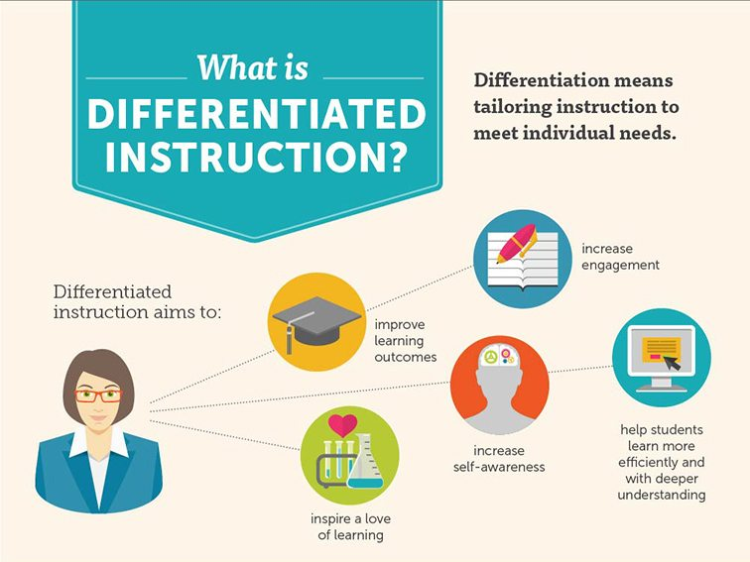

Slide 66
33. Vygotsky says that learning occurs in a social context. Which learning activity is most appropriate?
a. research
b. peer discussion
c. individual PowerPoint presentation
d. journal entry

Slide 67
Vygotsky's sociocultural theory asserts that learning is an essentially social process in which the support of parents, caregivers, peers and the wider society and culture plays a crucial role in the development of higher psychological functions.

Slide 68
34. Which is most likely the behavior if students whose minds are solely guided by the ID?
a. students would discuss and ask questions a lot
b. students would be very considerate and understanding with one another
c. students would find it difficult to wait patiently for their turn at the canteen when hungry
d. students would do more independent work

Slide 69
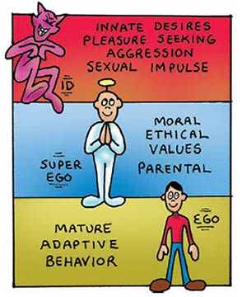

Slide 70
35. What is the equivalent of Education as “learning in any place, anytime and anywhere?”
a. flexible learning
b. research-based instruction
c. constructive education
d. outcomes-based curriculum

Slide 71
Flexible learning is a state of being in which learning, and teaching is increasingly freed from the limitations of the time, place and pace of study

Slide 72
36. In Bloom and Anderson’s Taxonomy in the hierarchy of cognitive learning, which comes first and lowest as a cognitive activity?
a. applying
b. creating
c. analyzing
d. remembering

Slide 73
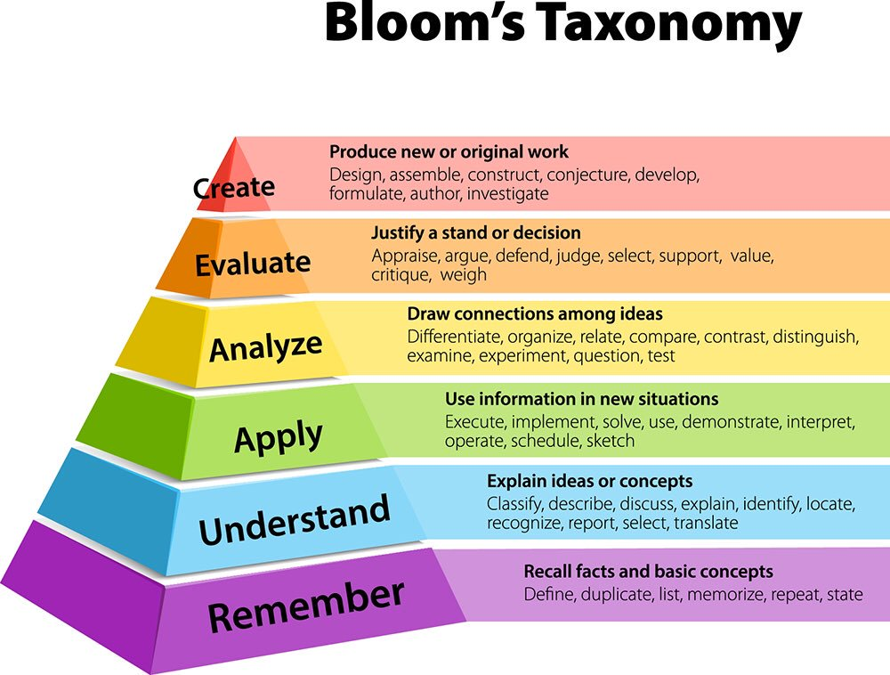

Slide 74
37. What can teacher Rosalie do to encourage class participation in her class?
a. allow students to go out during class hours
b. employ student-centered and fun learning
c. ask help of teacher peers
d. improve on hour-long lecture

Slide 75
Student-centered classrooms include students in planning, implementation, and assessments. Involving the learners in these decisions will place more work on them, which can be a good thing. Teachers must become comfortable with changing their leadership style from directive to consultative -- from "Do as I say" to "Based on your needs, let's co-develop and implement a plan of action."

Slide 76
38. Due to multiple intelligence and learning styles of learners, which approach works best in order to enhance learning of each and all students?
a. unilateral approach
b. horizontal approach
c. streamlined approach
d. differentiated approach

Slide 78
39. Among the curricula which operates in the classroom, which curriculum is actually applied in the teaching-learning process?
a. taught curriculum
b. hidden curriculum
c. written curriculum
d. recommended curriculum

Slide 79
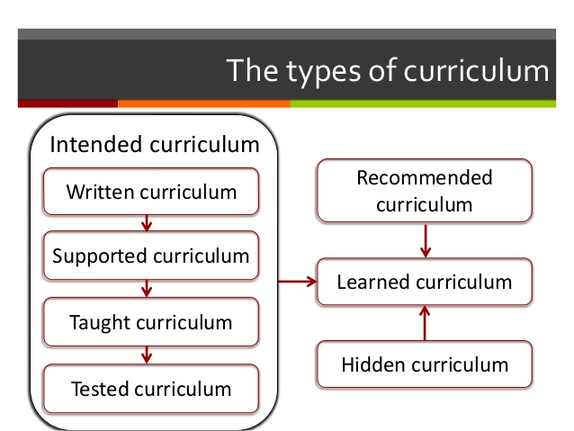

Slide 80
40. Among cognitive deficiencies, what is known as the difficulty in focusing or keeping attention in learning?
a. perception grasp disorder
b. language communication disorder
c. memory breadth disorder
d. attention deficit disorder

Slide 81
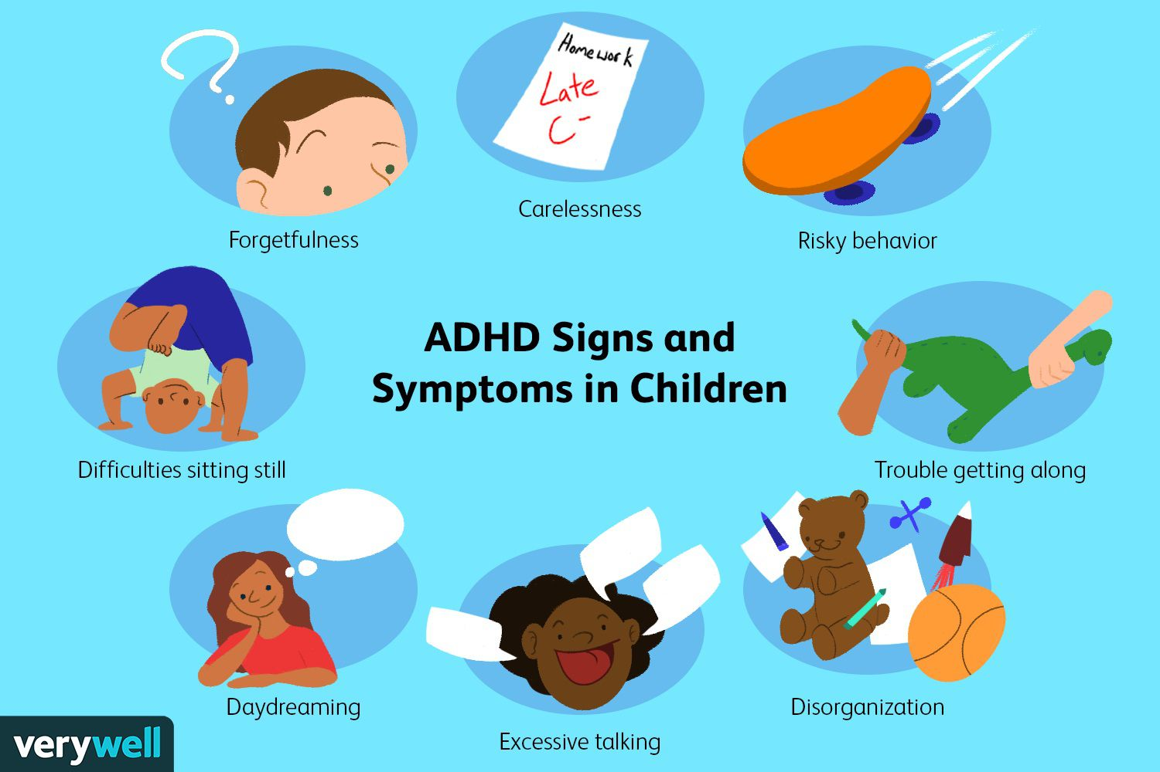

Slide 82
41. If the scores of your test follow a negatively skewed score distribution, what went wrong?
a. items were wrong
b. items were not in order
c. items were easy
d. items were difficult

Slide 83
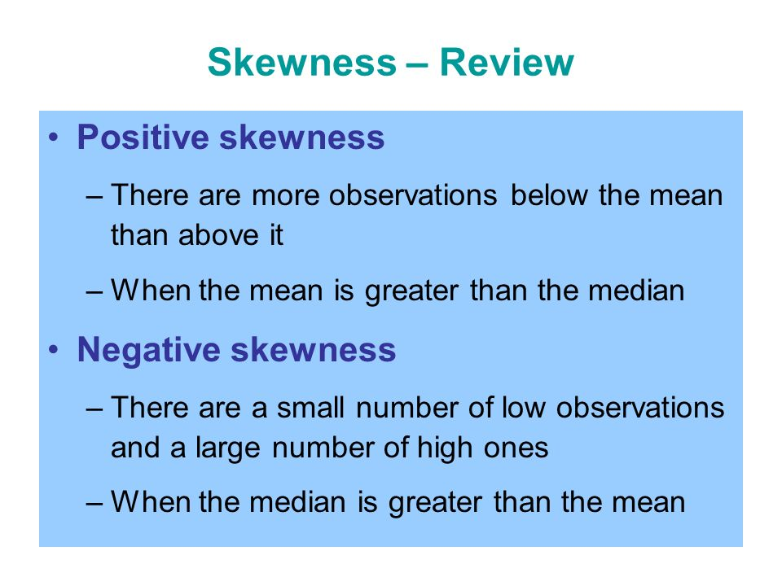

Slide 84
42. Which of the following shows a total physical environment that supports learning?
a. classroom with furniture
b. tall three-storied building
c. safe and secure building and classroom structures
d. bulletin boards in every building

Slide 85
“A conducive environment for learning, such as one with comfortable classroom set-ups, relevant use of teaching materials and interesting classroom activities, will further motivate the students to learn.

Slide 86
43. Among communication indicators, which can ensure effective communication between teacher and learners?
a. group dynamics
b. fun learning
c. two-way
d. technology-based

Slide 87
In two-way communication, communication is negotiated. Both sender and receiver listen to each other, gather information and are willing to make changes to work together in harmony. Their intent is to negotiate a mutually satisfactory situation.

Slide 88
44. What kind of presence is engaged in through the community of inquiry model?
a. social presence
b. psychological presence
c. individual presence
d. psycho-motor presence

Slide 89
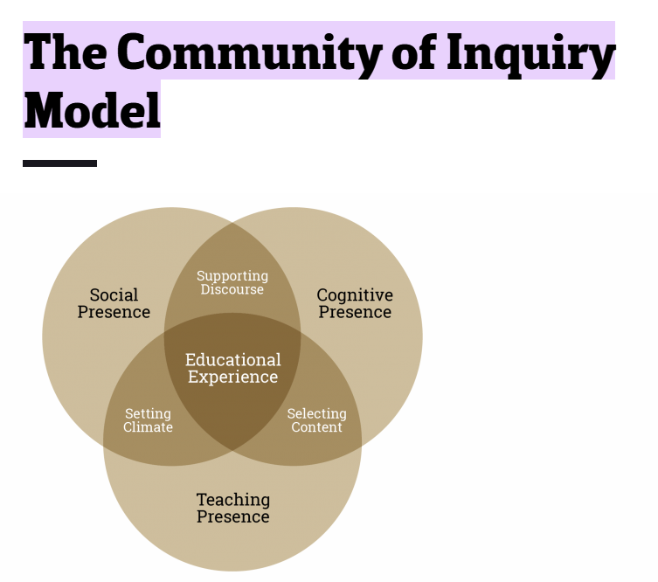
Social Presence is the ability to project the self socially and emotionally, thereby being perceived as “a real person” in mediated communication.
It consists of:
Communication between and with the instructor and all members of the class
Interaction with the instructor and all members of the class
Relation of a learning community throughout the term
Moves from introduction to community to camaraderie
Note: Social Presence is the main element needed before Cognitive and Teaching Presence can occur

Slide 90
45. What are equivalent to standards under the Philippine Professional Standards for Teachers?
a. cost of higher education
b. levels of qualification
c. certificates of training
d. accreditation of schools

Slide 91
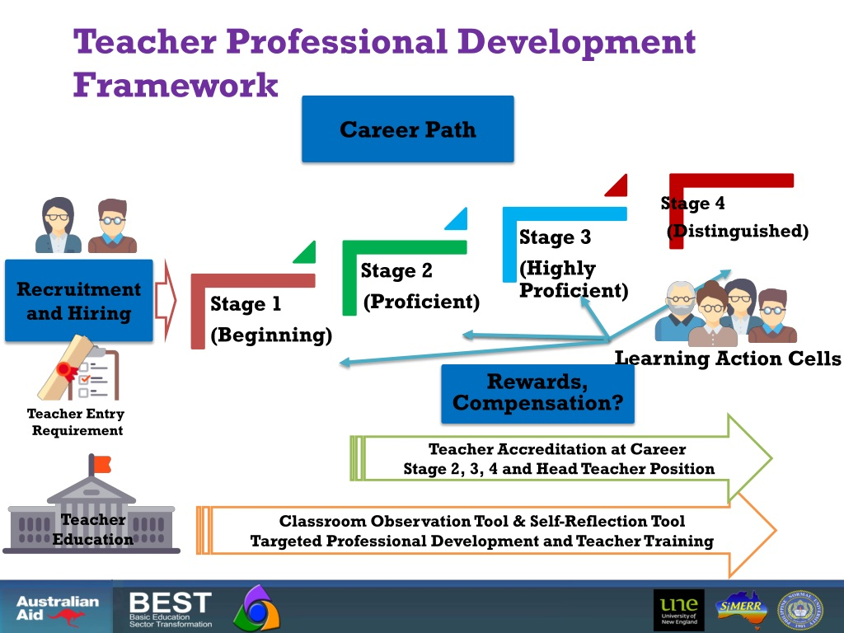

Slide 92
46. Which software is useful for text writing and organization in formulating articles or essays?
a. Microsoft Word
b. Database
c. PowerPoint
d. Spreadsheet

Slide 93
Microsoft Word is a word-processing program, designed to help you create professional-quality documents. With the finest document-formatting tools, Word helps you organize and write your documents more efficiently.

Slide 94
47. How is the bi-semester grade per subject for Grades 1-to-10 computed?
a. by grade average for 2 quarters
b. by grade average the whole year
c. by grade average each month
d. by grade average each week

Slide 95
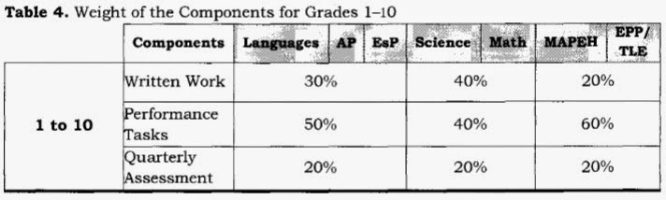

Slide 96
48. Which portfolio can demonstrate skills e.g. using the microscope?
a. showcase portfolio
b. process portfolio
c. development portfolio
d. assessment portfolio

Slide 98
49. What factor is given the most importance by Teacher Nikki who is teaching in a school for children in a poverty-stricken slum area?
a. children’s beliefs
b. children’s ethnicity
c. children’s race
d. children’s socio-economic status

Slide 99
Socioeconomic status was defined as having three dimensions: family income, parents' education level, and parents' occupational prestige.

Slide 100
50. Which of the following is significant/related to cognitive development in the child?
a. one involving memorizing a poem
b. one involving feelings for a mother
c. one involving physical enlargement of the brain
d. one involving increase in weight

Slide 101
Cognitive development means how children think, explore and figure things out. It is the development of knowledge, skills, problem solving and dispositions, which help children to think about and understand the world around them. Brain development is part of cognitive development.

Slide 102
51. How is referent power best exhibited by the teacher on the first day of school?
a. reminding your students your authority over them
b. giving students a sense of acceptance and belonging
c. making students feel you know what you are talking about
d. telling students, the importance of good grades

Slide 103
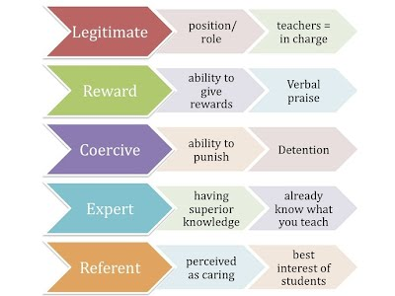

Slide 104
52. Which of the following is the correct feature that characterize the Indigenous Peoples Education Curriculum?
a. stamped out cultural identity
b. reduced use of indigenous languages
c. exclusivist curriculum paradigm
d. anchored learning context on ancestral domain

Slide 105
IPEd Curriculum Framework seeks to provide guidance to schools and other education programs, both public and private, as they engage with indigenous communities in localizing, indigenizing, and enhancing the K to 12 Curriculum based on their respective educational and social contexts.

Slide 106
53. According to Maslow, what satisfaction is reached as the final result of psychological harmony with reality?
a. self-esteem
b. ego-actualization
c. sovereignty
d. belongingness

Slide 107
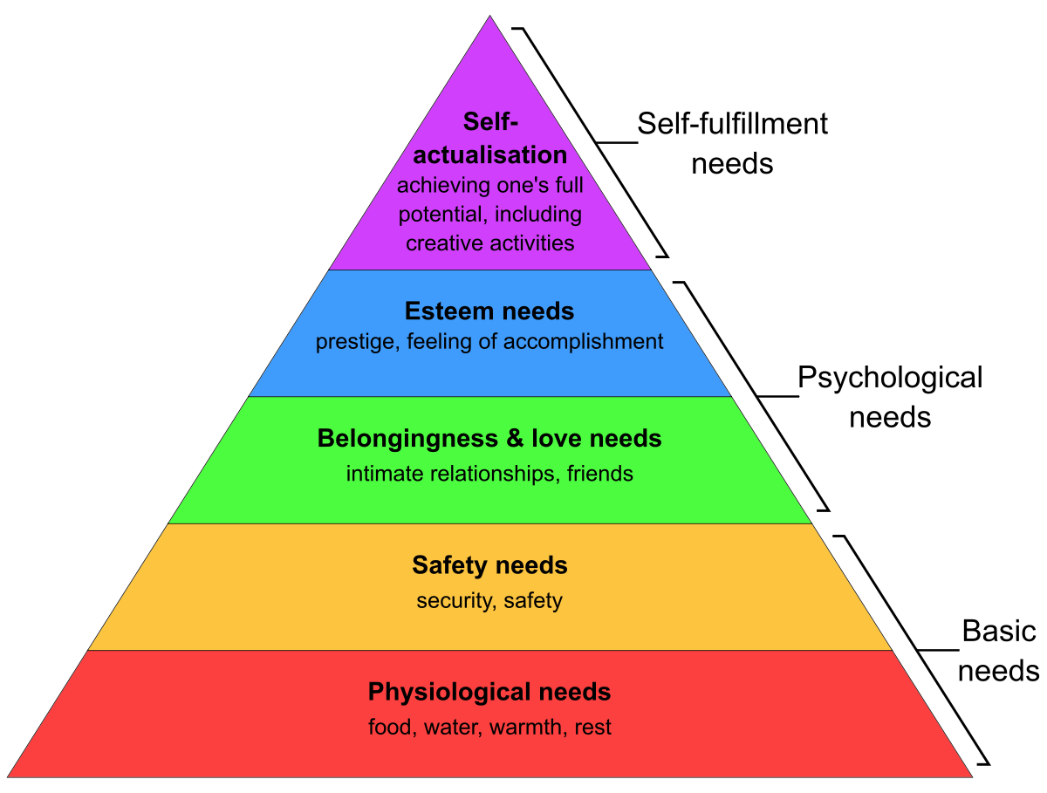

Slide 108
54. When a student gathers data or information and arrives at a conclusion, what process of research is followed?
a. induction
b. deduction
c. implication
d. experiment

Slide 109
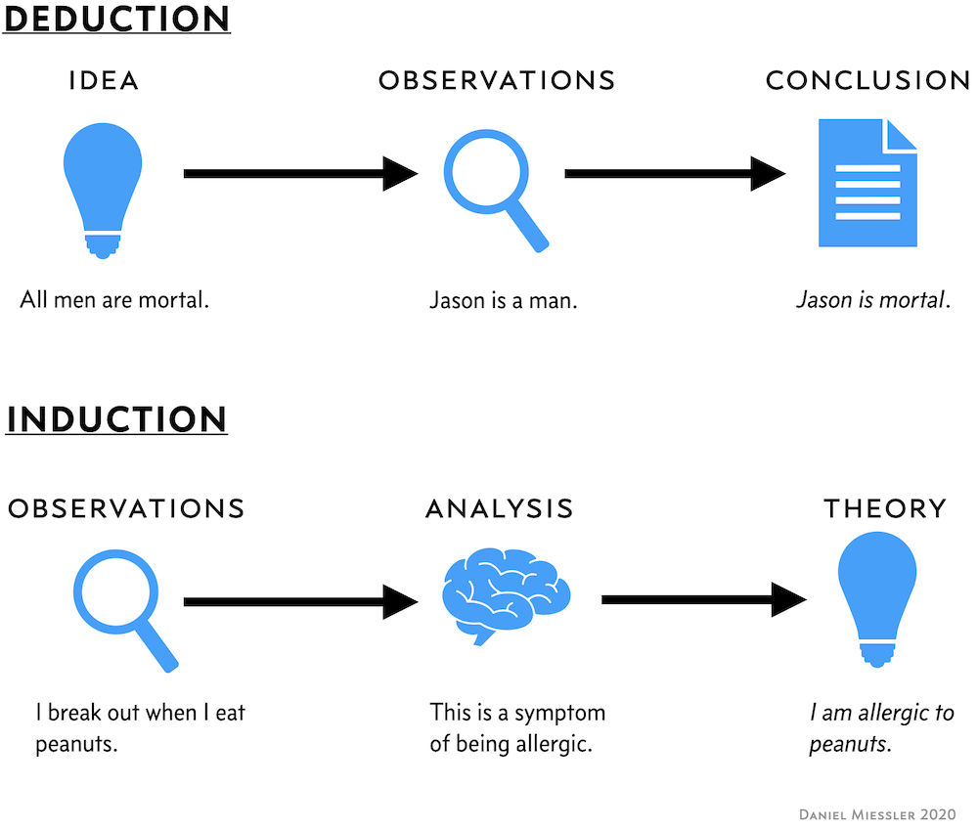

Slide 110
55. What kind of assessment of learning can provide information about achievement levels across individual learner?
a. assessment of motivation
b. assessment of learning styles
c. assessment of performance
d. assessment of ethnicity

Slide 111
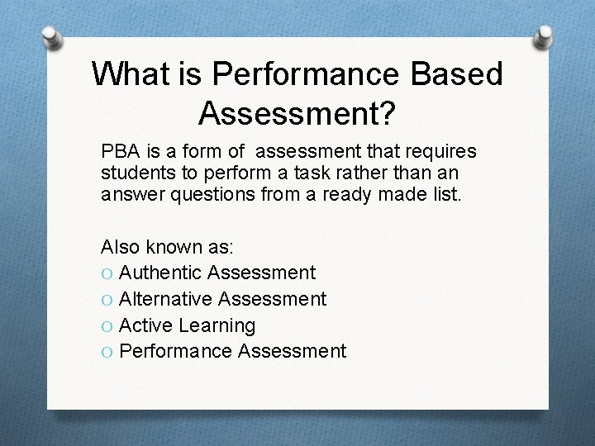

Slide 112
56. Which task is appropriate for an outcome that demonstrate research writing?
a. research data gathering
b. research definition of terms
c. research question formulation
d. research project report

Slide 113
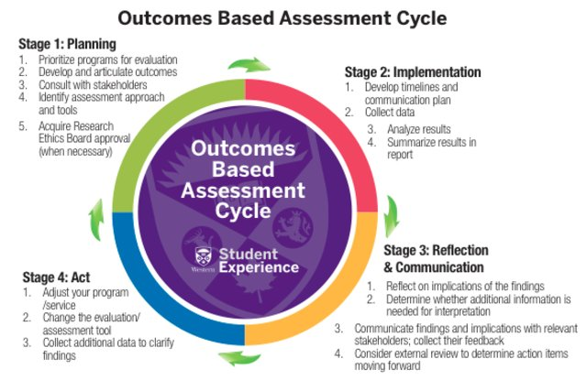

Slide 114
57. What does evidence-based practice imply?
a. base your intended research on a list of past researches
b. instructional practice must be supported by rigorous research findings
c. research is a criterion for teacher promotion
d. teachers are engaged in research

Slide 115
Evidence-based practices in education are the same. They are backed by rigorous, high-standard research, replicated with positive outcomes and backed by their effects of student outcomes. EBPs take the guess work out of teaching by providing specific approaches and programs that improve student performance. There is frustration in teaching when you cannot find a way to help your student learn. You try one thing and then another and another and they are not having positive outcomes for your student. EBPs have proven outcomes on students’ performance and can make finding and implementing an effective practice less frustrating.

Slide 116
58. What is the descriptor for a numerical grade of 80 as level of proficiency?
a. satisfactory
b. advanced
c. very satisfactory
d. outstanding

Slide 117
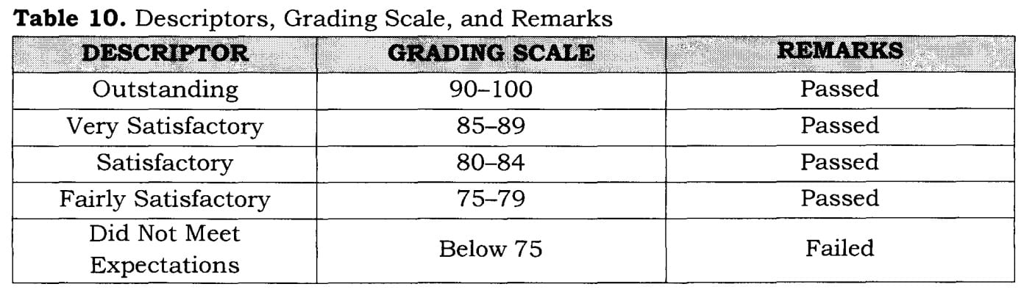

Slide 118
59. When is it best for teacher Anna to set up classroom routines, e.g., passing of paper, seeking permission in class, etc.?
a. at the end of the year
b. in the middle of the year
c. at start of every class
d. at the start of the year

Slide 119


Slide 120
60. Which is true of a constructivist teaching learning process? I. based on students’ questions and interests II. interactive III. dialogue IV. group work
a. II and III
b. I and IV
c. I and II
d. I, II, III and IV

Slide 121
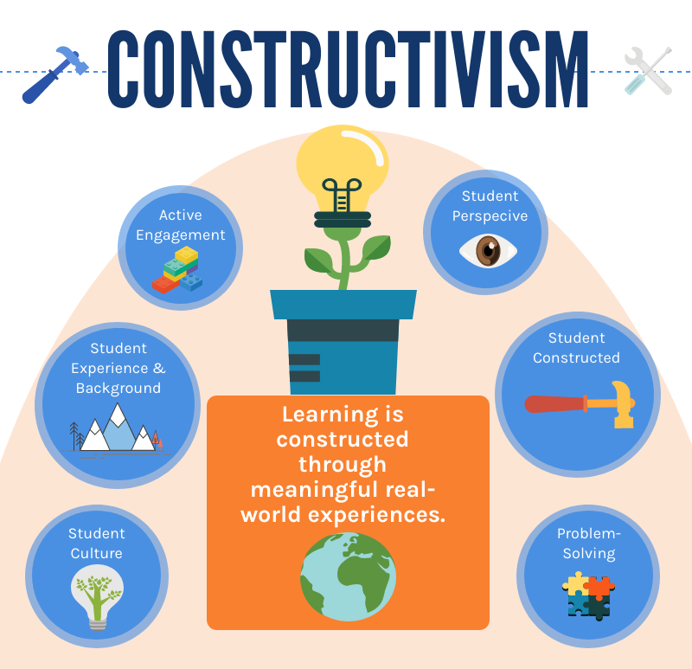

Slide 122
61. When will parents find reporting of grades of their children meaningful?
a. by distributing grade report cards
b. by comparing grades of individual students
c. by telling parents the limitations of their children
d. by explaining grades and performance of students

Slide 123
Report cards are a great way for parents to know how their child is performing in school. "The purpose of report cards is to convey information from the school to parents about a student's educational progress."(Friedman,1995)

Slide 124
62. At what level of Kohlberg’s stages of moral development is taxi driver Ed returning the wallet of a passenger who left it in his cab?
a. preconventional for the reward money
b. preconventional for fear of punishment
c. conventional for social approval of what other people will say
d. post-conventional for the common good

Slide 125
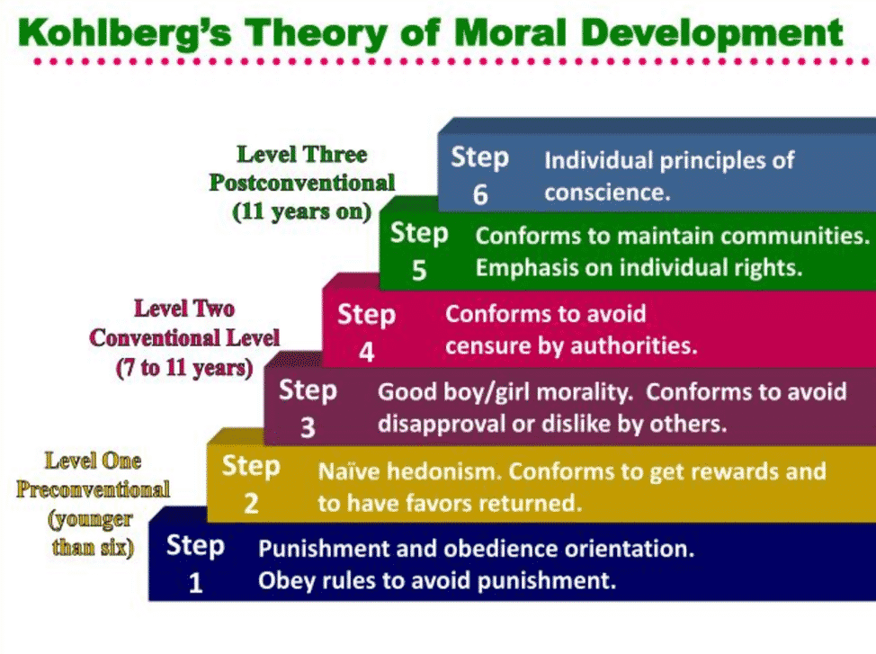

Slide 126
63. What cognitive process is required in writing a personality profile of a fellow classmate?
a. creating
b. applying
c. recalling
d. analyzing

Slide 127
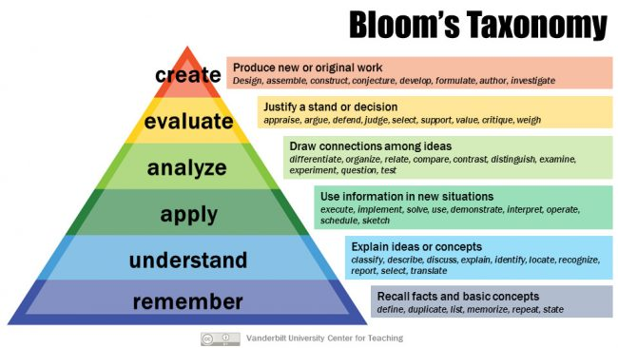

Slide 128
64. What is meant by action research following a cyclical process?
a. problems occur again and again like a cycle
b. teachers form a circle during meetings
c. the circle of participants change from time to time
d. effort is continuing until problem is resolved

Slide 129
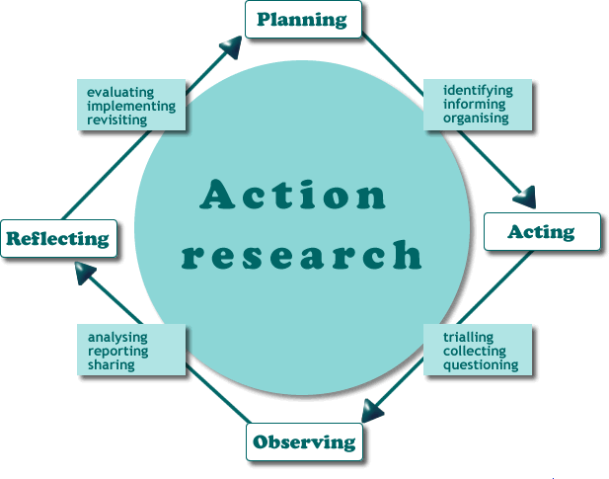

Slide 130
65. During the COVID virtual learning, what is missed by learners?
a. cyber interchange
b. face-to-face teaching-learning
c. on-line instruction
d. virtual interaction

Slide 131
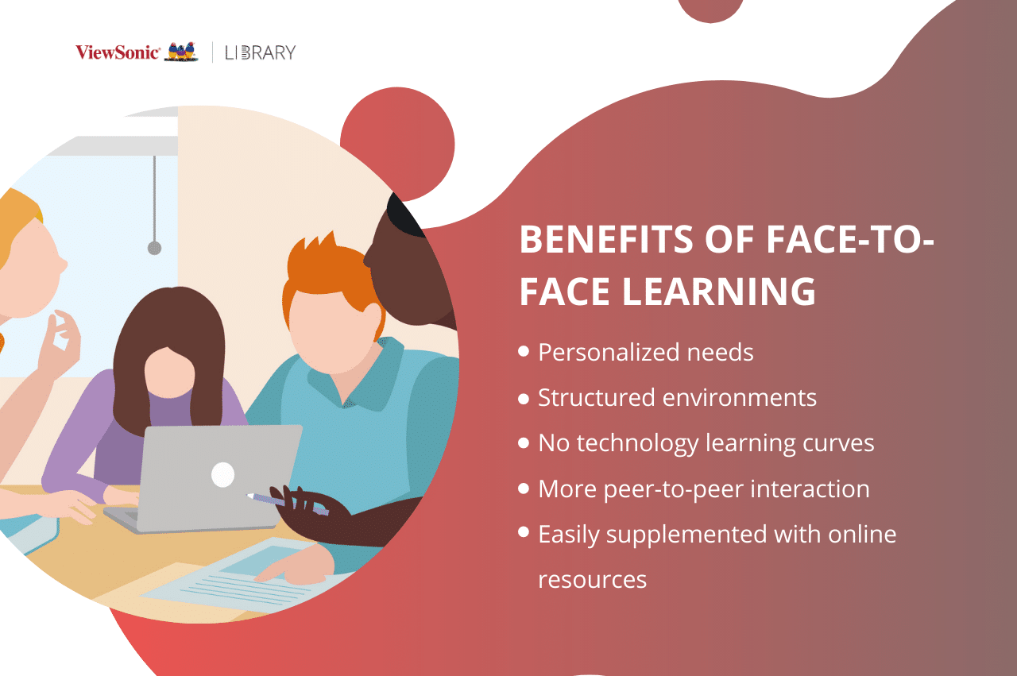

Slide 132
66. Which of the following expresses spirituality among professional teachers?
a. advocacy for universal values, e.g., love, services, freedom, etc.
b. performing civic duties, e.g., voting on election day
c. regularity in church duties e.g., mass, rosary, praying, etc.
d. conformity with school rules e.g., uniform dress attire

Slide 133
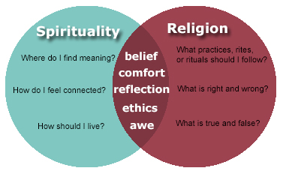

Slide 134
67. In the 4 factors of Bandura’s social learning theory, what influence do teachers and parents have on the young?
a. social persuasion
b. mastery experience
c. emotional states
d. vicarious experience

Slide 135
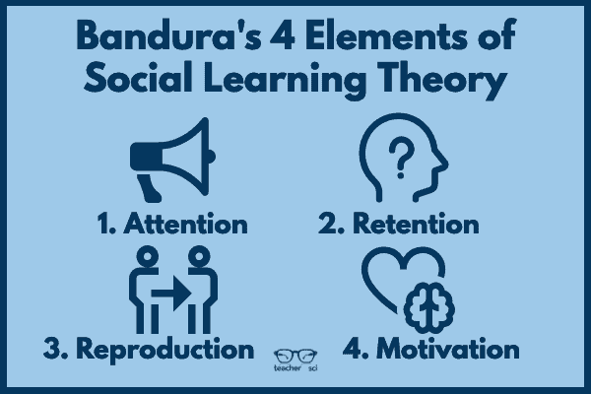

Slide 136
68. In a multiple-choice test, what are the choices that correspond to the list of concepts?
a. decoys
b. contrasts
c. opposites
d. alternatives

Slide 137
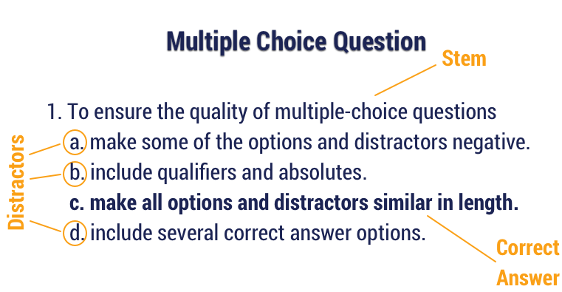
A multiple-choice item consists of a problem, known as the stem, and a list of suggested solutions, known as alternatives. The alternatives consist of one correct or best alternative, which is the answer, and incorrect or inferior alternatives, known as distractors.

Slide 138
69. What is most important in monitoring progress of the curriculum?
a. observing if learning outcomes are accomplished
b. grading of project and assignment outputs
c. determining the outstanding teachers in the school
d. limiting absences of students and teachers

Slide 139
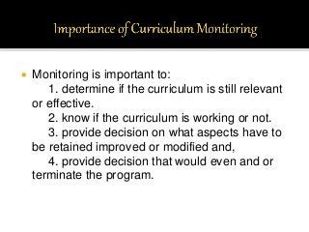

Slide 140
70. What factor should teacher Cess be careful about when she is teaching in a school for children in a poverty-stricken slum area?
a. children’s beliefs
b. children’s socio-economic status
c. children’s ethnicity
d. children’s race

Slide 141
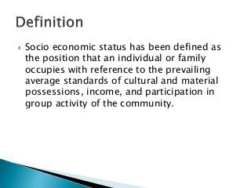

Slide 142
71. Which of the following has higher importance than the rest as to best practice of a professional teacher?
a. competency supported by continuing growth
b. appearance as a teacher in dress and attire
c. loyalty to the school by years of service
d. regularity in class attendance

Slide 143
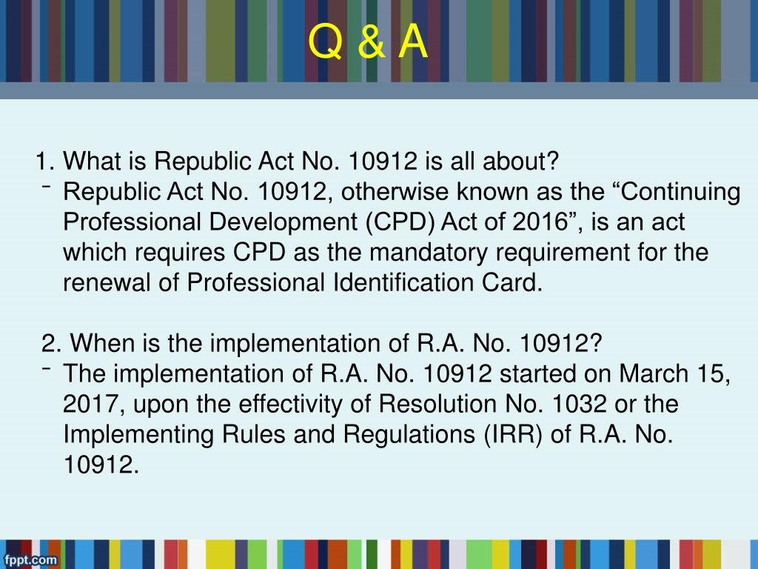

Slide 144
72. What kind of parents can most likely foster a sense of responsibility among children?
a. permissive
b. autocratic
c. democratic
d. neglecting

Slide 145
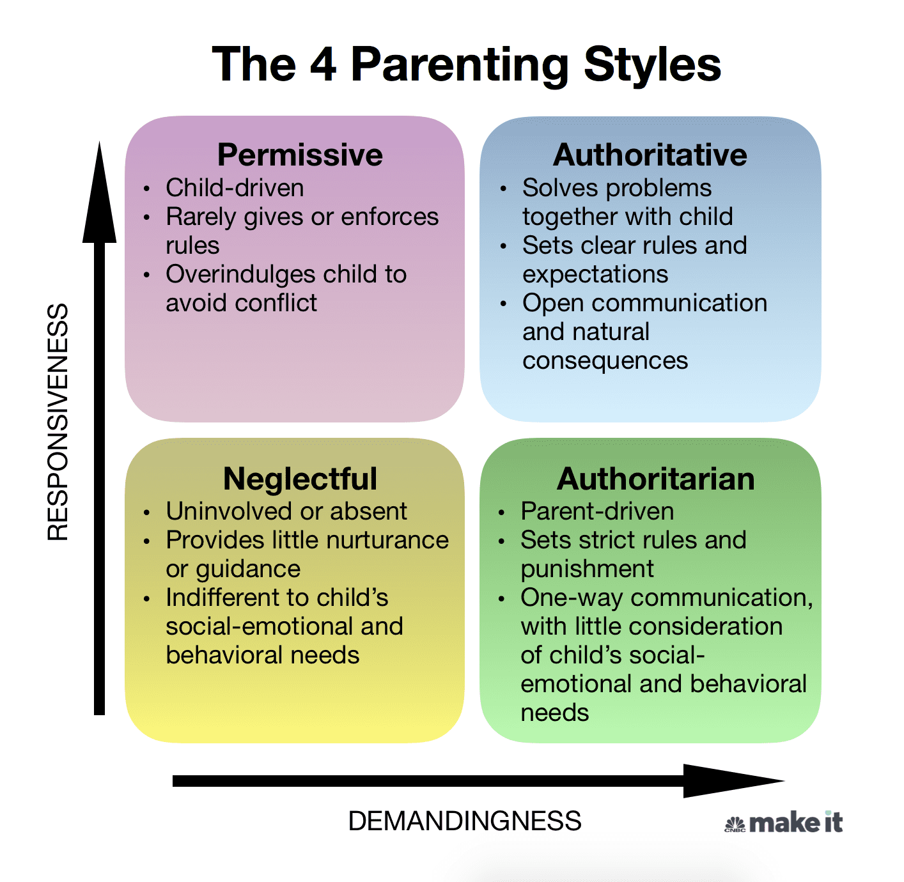

Slide 146
73. Which research finding regarding use of the mother tongue as language of instruction is TRUE? The use of mother tongue _____ the learning of the second language.
a. enhance
b. delays
c. does not affect
d. hampers

Slide 147
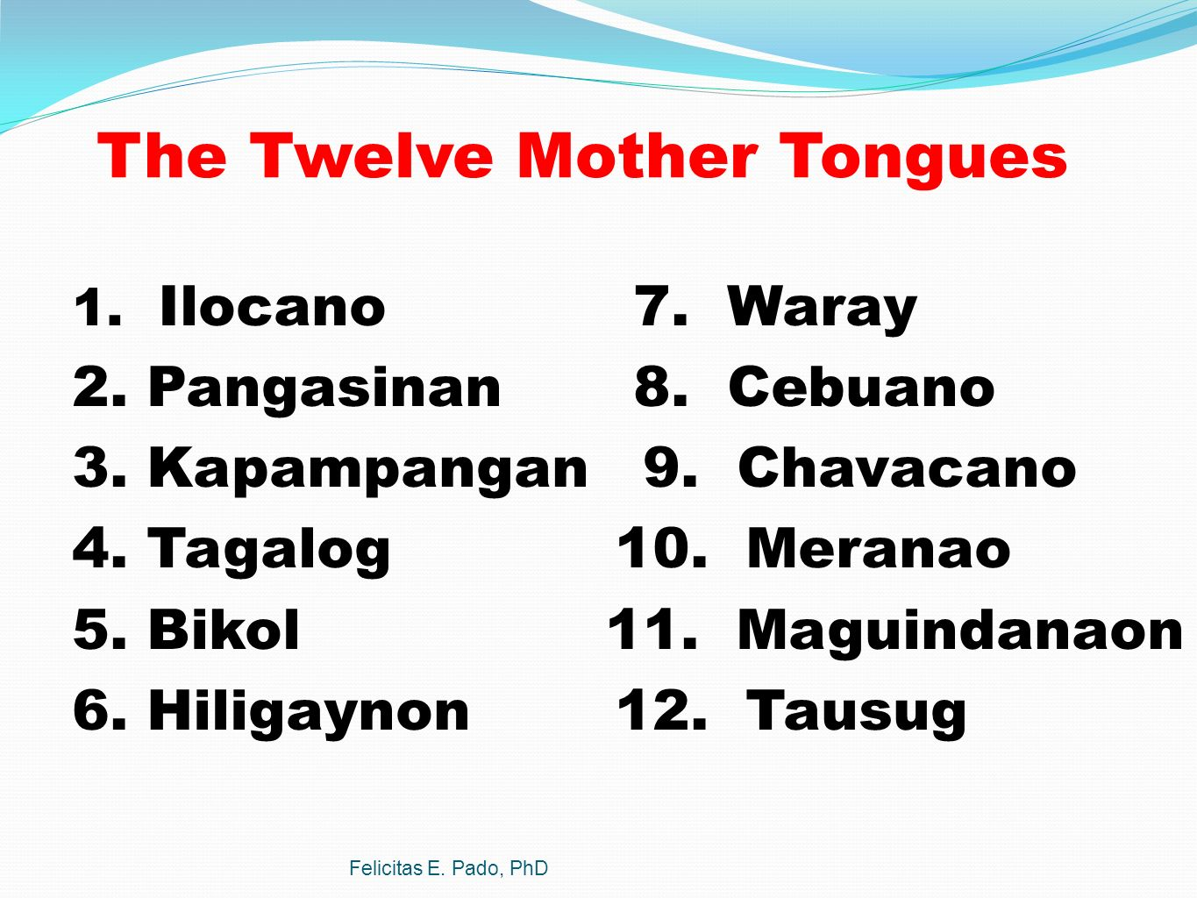

Slide 148
74. What is the main objective of action research in instruction and school management?
a. it aims at strengthening authority of principals
b. it seeks to solve instructional and school problems
c. it aims at increasing the work of teachers
d. it seeks to make students loyal to the school

Slide 149


Slide 150
75. Which of the following shows the teacher’s respect for human dignity?
a. joining professional associations
b. using social media
c. working with people of different views
d. practicing diligence and industry

Slide 151
Human dignity is the recognition that human beings possess a special value intrinsic to their humanity and as such are worthy of respect simply because they are human beings.

Slide 152
76. Which of the following will most likely help students internalizing classroom rules?
a. teacher explaining the rules to students to follow
b. student participation in setting rules
c. students following teacher’s rules
d. teacher formulation the rules

Slide 153
Developing rules alongside students is when teachers facilitate a conversation with and among the students to determine moral expectations for the classroom. This tool is helpful because it fosters student ownership in the classroom and responsibility among the students for their behaviors.

Slide 154
77. On classroom activities, the following are appropriate for learners who have good logical-mathematical skills, but NOT to include
a. storytelling
b. number games
c. experiments
d. calculations

Slide 155
Logical-Mathematical Intelligence is the ability to analyze situations or problems logically, identify solutions, conduct scientific research, and easily solve logical/mathematical operations. It is one of the eight multiple intelligence types proposed by Howard Gardner.

Slide 156
78. In addition to showing grades of students to their parents, which can be shown to demonstrate performance?
a. teacher’s syllabus
b. memorandum of the principal
c. copy of curriculum
d. written work

Slide 157
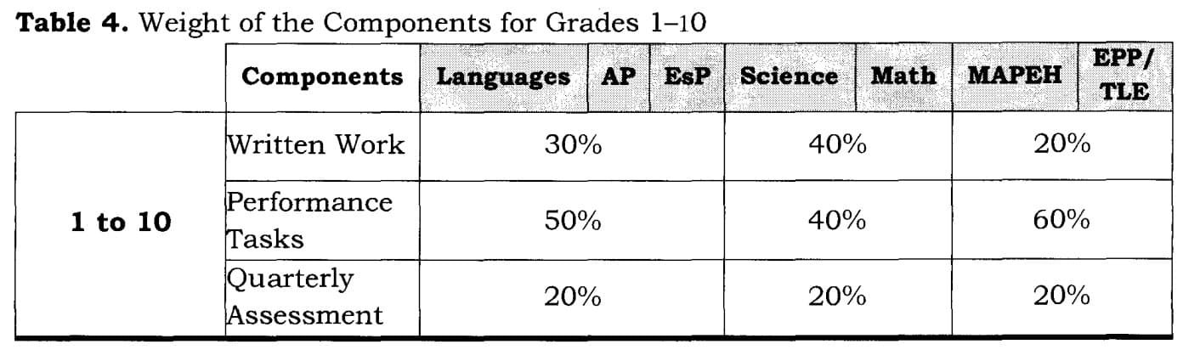

Slide 158
79. On the reasoning process, which is used for pure philosophy that is a deductive, rather than an inductive science?
a. it starts from prior ideas in the mind
b. it starts with the real outside the mind
c. it relates external reality to mental reality
d. it starts from the real to the mental

Slide 160
80. What kind of assessment is the complied materials like reflections, photos, school leaflets, etc. from internship of senior students?
a. portfolio
b. project
c. essay
d. test

Slide 161
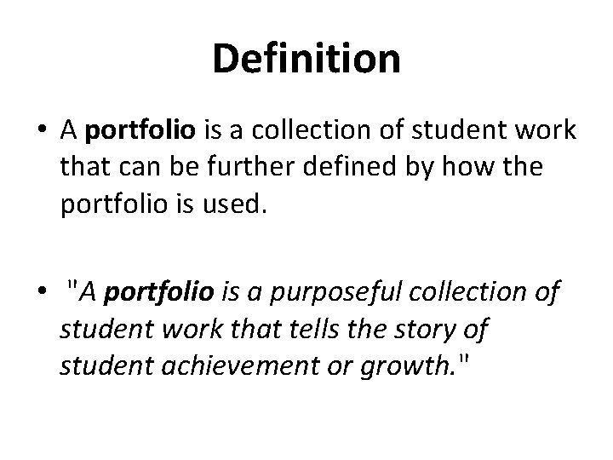

Slide 162
81. RA 10157 states: “Mother Tongue shall be the primary medium of instruction in kindergarten.” Which are exceptions? I. when the teacher does not speak the mother tongue of the learners II. when the K-pupils speak different mother tongues III. when resources in the MT are not available IV. when teachers are not yet trained
a. I, II, III and IV
b. III only
c. I and II
d. II only

Slide 163
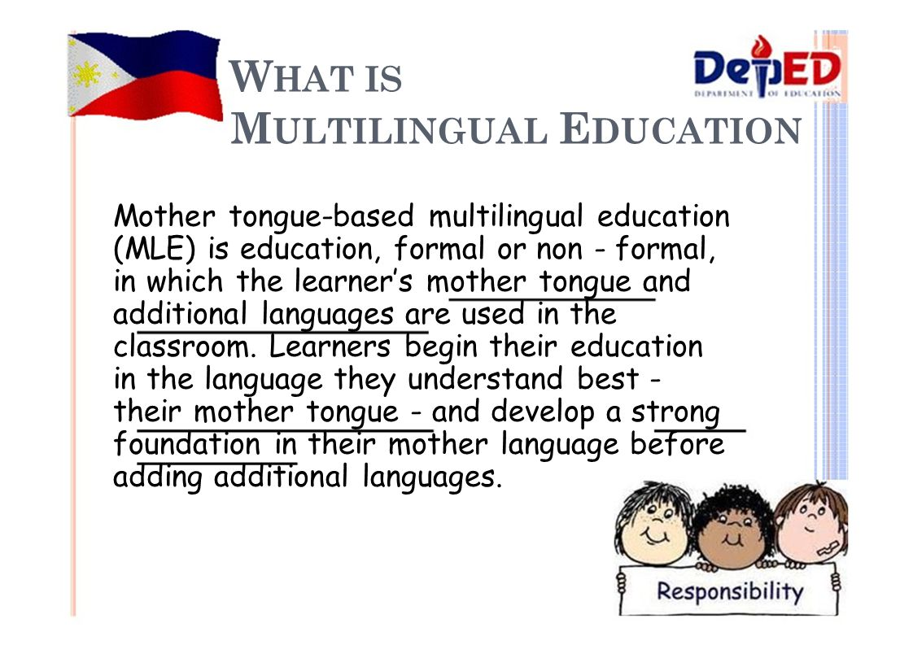

Slide 164
82. Does assessment FOR learning occur when the teacher gives instruction to ensure that the intended learning outcomes are attained?
a. Yes
b. Partially yes
c. No
d. Partially no

Slide 165
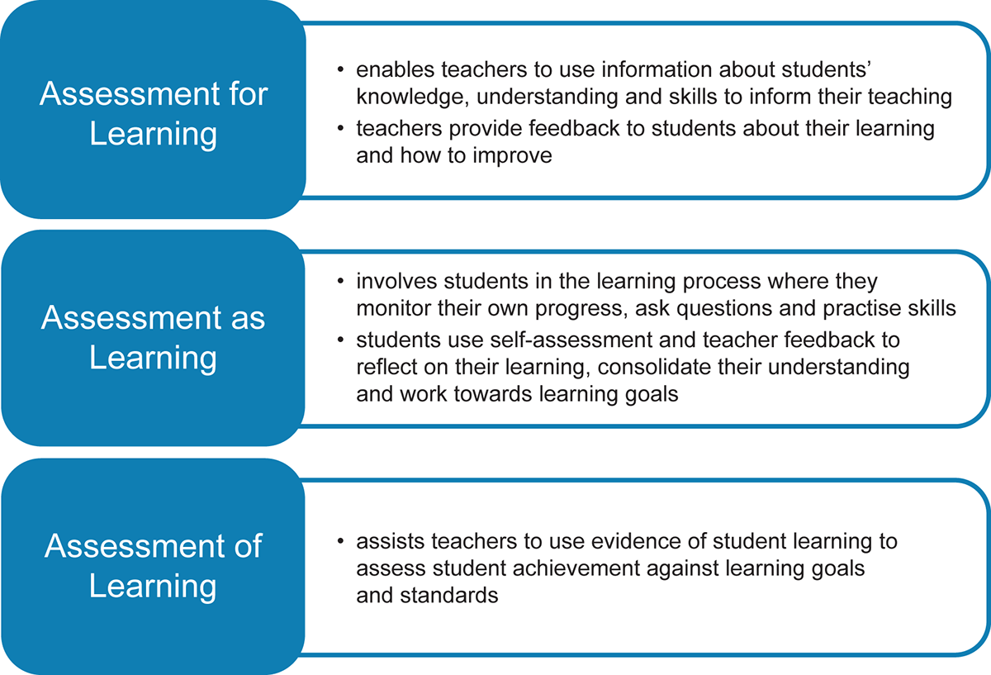

Slide 166
83. For what response is continuing professional education or CPE installed for every professional teacher?
a. past ideas and practices
b. monitoring of educational programs
c. new trends and reforms
d. review of academic achievement

Slide 167


Slide 168
84. On learning deficiencies, what is known as a learning disability in number operation?
a. dyscalculia
b. dysgraphia
c. dyslexia
d. dyspepsia

Slide 169
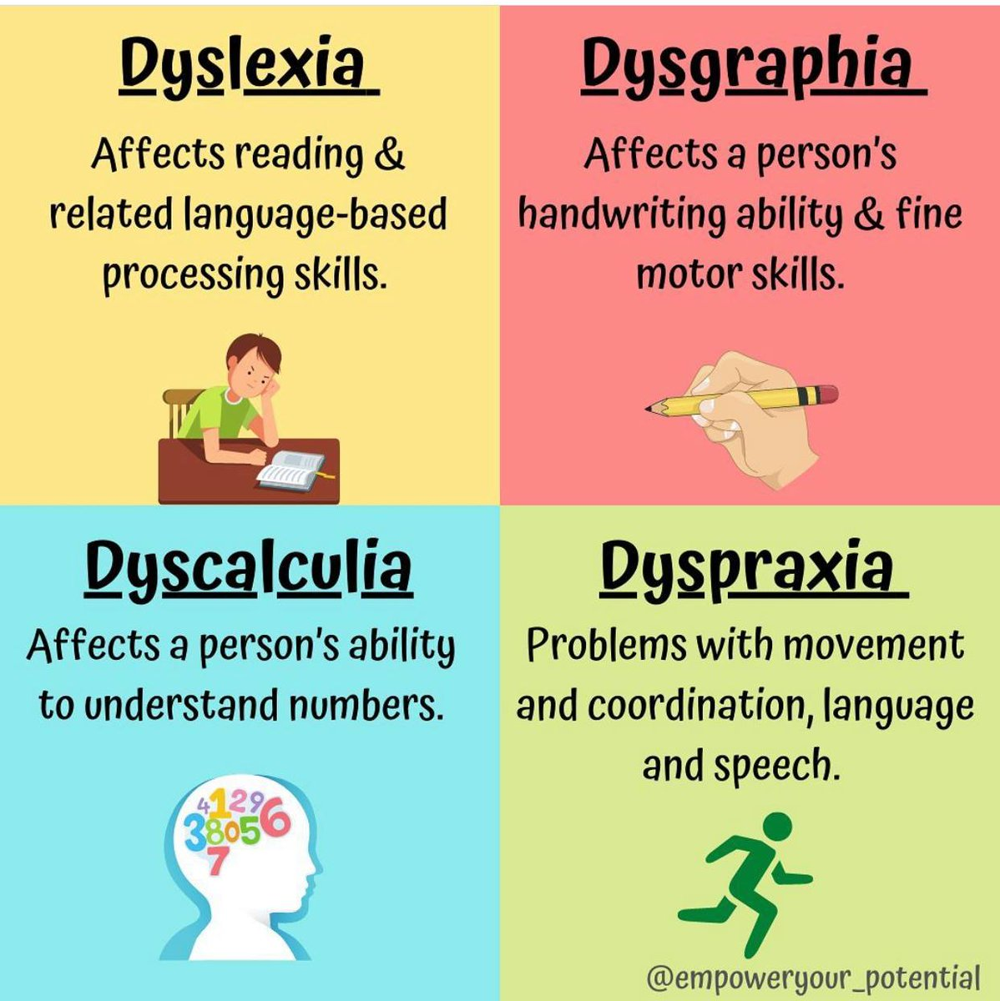

Slide 170
85. On periods of development, what feature characterizes the child in infancy stage?
a. social attachment
b. well established language
c. team play
d. puberty

Slide 171


Slide 172
86. To ensure lesson mastery, which one/s should teacher use? I. Formative tests II. Summative tests III. Diagnostic tests
a. I and II
b. II and III
c. I and III
d. I, II and III

Slide 173
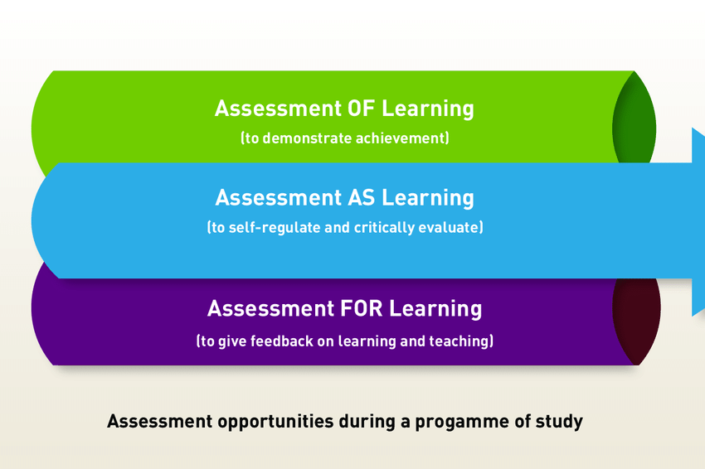

Slide 174
87. What variation of storytelling involves children telling a story with the use of materials, sets and props?
a. story enactment
b. puppet stories
c. flannel board stories
d. lap board stories

Slide 175
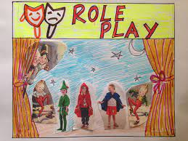

Slide 176
88. Situation: In a multiple-choice test item with A, B, C, and D as option and with C as the correct answer, out of 50 students nobody chose A, 15 chose B, 10 chose C and 25 chose D. Which is the most effective distracter?
a. A
b. D
c. C
d. B

Slide 177
When distractors are ineffective and obviously incorrect as opposed to being more disguised, then they become ineffective in assessing student knowledge. An effective distractor will attract test takers with a lower overall score than those with a higher overall score.

Slide 178
89. What reason will you give to justify the fact that the philosophy is a deductive, rather than an inductive science?
a. it starts from the real to the mental
b. it starts with the real outside mind
c. it starts from prior ideas in the mind
d. it relates external reality to mental ability

Slide 179
Both deduction and induction are a type of inference, which means reaching a conclusion based on evidence and reasoning. Deduction moves from idea to observation, while induction moves from observation to idea.

Slide 180
90. What are characteristics of a good classroom layout, structure?
a. it is made of concrete not wood material
b. it ensures a clean, safe and secure environment
c. it fits the aesthetic taste of the principal
d. it accommodates desk and chairs

Slide 181
“A conducive environment for learning, such as one with comfortable classroom set-ups, relevant use of teaching materials and interesting classroom activities, will further motivate the students to learn.

Slide 182
91. What is the philosophy behind Philippine schools that seek to promote democratic opportunities for all and humanistic education through lifelong learning?
a. perennialism
b. classical education
c. positivism
d. progressivism

Slide 183
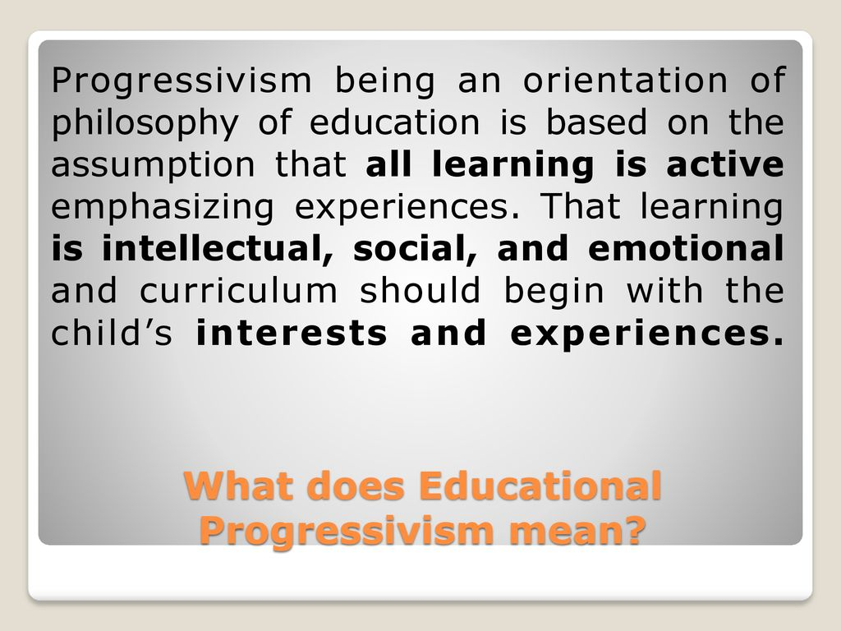

Slide 184
92. Complete the analogy. School heads: National competency-based standards for school Head::teachers: ____________________
a. National competency-based teacher standards
b. Professional Philippine standards for teachers
c. National competency-based teaching standards
d. Philippine professional standards for teachers

Slide 185


Slide 186
93. Which contributes to balance in sexuality in male and female?
a. myelin sheet
b. blood vessels
c. hormones
d. chromosomes

Slide 187
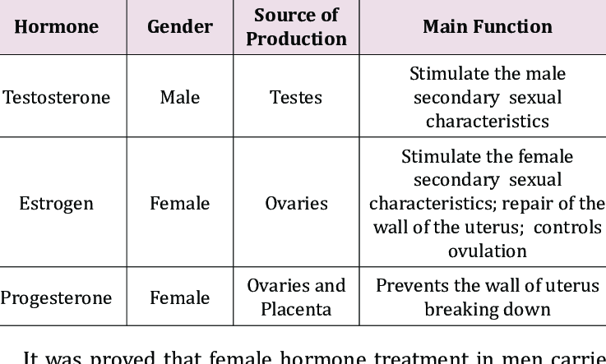

Slide 188
94. What role is the library or learning resource center fulfilling by helping students and teachers find resource materials in other schools which are part of their consortium of schools?
a. coordinating
b. training
c. instructing
d. researching

Slide 189
A learning resource center (LRC) is a facility within a school, staffed by a specialist, containing several information sources to facilitate education for students and staff. It differs from a regular school library in its additional focus on multimedia resources and information technology.

Slide 190
95. Which of the following comments by the teacher can likely motivate learners to try harder rather than give up on learning?
a. “Ok lang kung hindi natin maunawaan, bahala na ang diyos sa atin”
b. “Hayaan lang nating mang-unawa ang magagaling sa atin”
c. “Bigyan natin ng panahon, at lalaban din ang ating pang unawa ng paksa”
d. “Kapag mahirap ang paksa, mahirap din matutunan ito”

Slide 191


Slide 192
96. Which item in newspapers demonstrates critical thinking worthwhile for instruction on current issues and events?
a. society page
b. opinion page
c. entertainment page
d. news page

Slide 193


Slide 194
97. Based on the enhanced basic education Act of 2013, which does basic education in the Philippines encompass? I. kindergarten II. elementary III. secondary IV. alternative learning system
a. I and II
b. I, II and III
c. II and III
d. I, II, III and IV

Slide 195
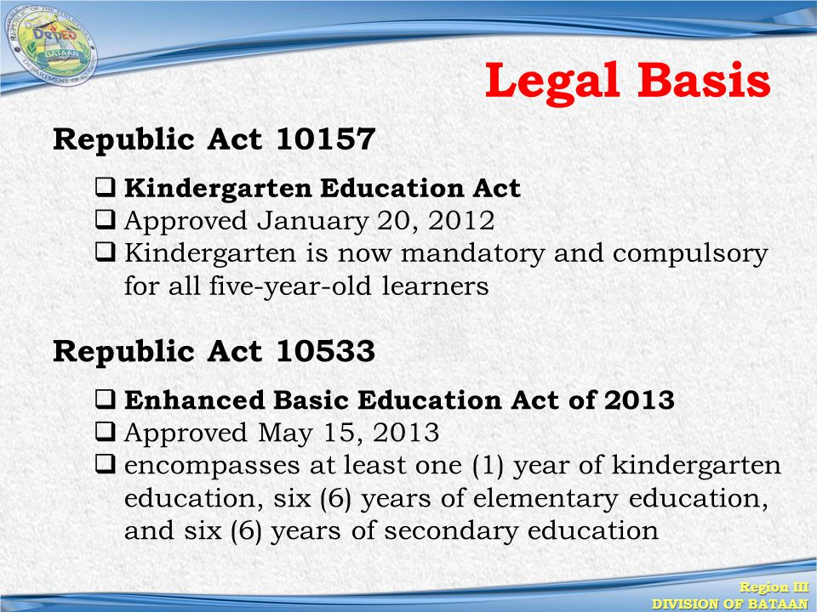

Slide 196
98. What is the appropriate aim of action research in school?
a. advance the physical sports program
b. identify leaders in school clubs
c. resolve current issues in the school
d. blame students for bullying and other misdemeanor

Slide 197
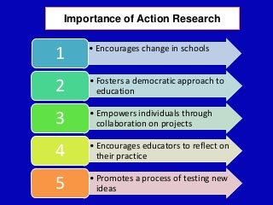

Slide 198
99. The following describes a learner with initiative that is appropriate for 21st century learning EXCEPT:
a. inventiveness
b. drive
c. indolence
d. ambition

Slide 199
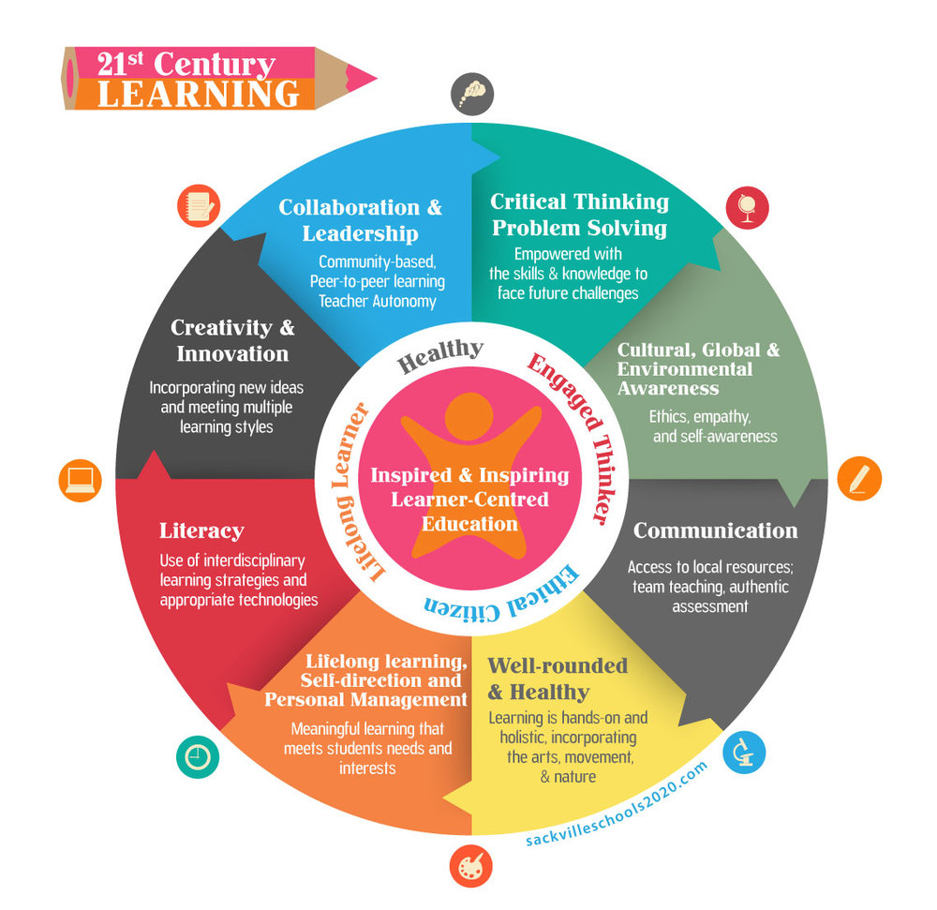

Slide 200
100. What roles does a teacher do when he/she draws out the capacity of learners to assimilate organize and produce ideas, while controlling the pace (slow or fact) of learning?
a. facilitator
b. lecturer
c. tutor
d. adviser

Slide 201
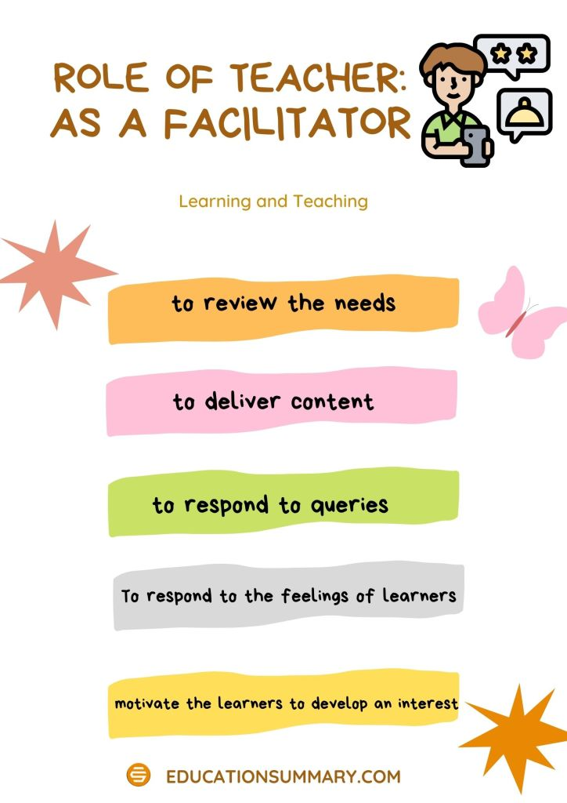

Slide 202
101. How will you characterize a filling the blanks question has too many blanks?
a. over mutilated
b. unrealistic
c. simple
d. implausible

Slide 203
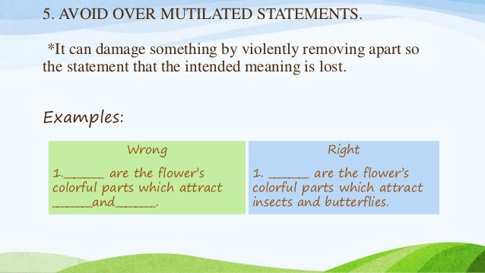

Slide 204
102. How does a purely behaviorist teacher explain the observation of a child enjoying school?
a. he taught life skills
b. he feels he belongs
c. he is rewarded for his good performance
d. learning is highly personalized

Slide 205
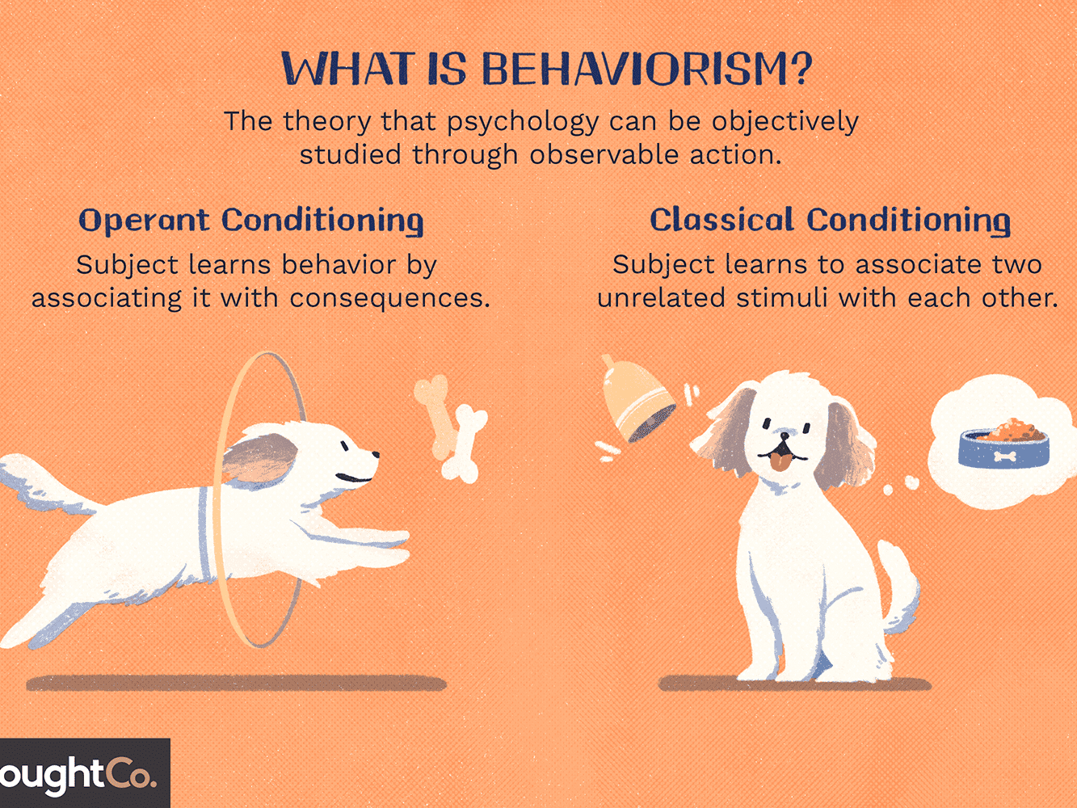

Slide 206
103. In designing a curriculum which is the component that regulates weekly, semestral land annual schedules for curriculum implementation?
a. time-frame
b. assessment
c. subject matter
d. learning outcomes

Slide 207


Slide 208
104. As teachers, what kind of web application or app do we need in order to be more efficient and productive in our use of platforms on the internet?
a. financial app
b. instructional app
c. management app
d. inventory app

Slide 209
Teacher-support instructional applications: Software or applications specifically designed to support teachers in instructional processes. Examples include attendance software; grading applications; testing systems; student work or portfolio systems; lesson planning software.

Slide 210
105. In Freud’s theory of psychoanalysis, which best represents the super-ego among students?
a. their ideals in life
b. their industry in work
c. their self-esteem
d. their self-confidence

Slide 211


Slide 212
106. In modern times, what is one important contribution of machines to the educational work of teachers and schools?
a. to demonstrate caring for children
b. to enhance teaching and learning
c. to demonstrate caring for children
d. to replace teachers in school

Slide 213


Slide 214
107. On lifespan perspectives, which message best describes as a lifelong process?
a. we change as the world changes around us
b. we continue to learn and flourish in life
c. we gain capacity for logical though in school
d. we enhance in socializing as important to maturing

Slide 215


Slide 216
108. When is the most appropriate time to set up routine activities for effective classroom management?
a. periodically during the year
b. as soon as the students adjusted to classes
c. on the first day of classes
d. every day of classes

Slide 217


Slide 218
109. What is the descriptor for a numerical grade of 80 as level of proficiency?
a. very satisfactory
b. outstanding
c. satisfactory
d. advanced

Slide 220
110. What is the learning paradigm involved in school physical exercise drills before entering classrooms?
a. observation
b. reward
c. punishment
d. conditioning

Slide 221


Slide 222
111. Which is the most recent and comprehensive among norms for professional standards for Philippine teachers?
a. Continuing professional development
b. Professional code of ethics
c. Philippine professional standards for teachers
d. National competency-based teacher standards

Slide 223


Slide 224
112. What do students miss while engaging in virtual learning during the COVID 19 pandemic?
a. face to face learning
b. flexible learning
c. distant learning
d. blended learning

Slide 226
113. A teacher is a “trustee of the cultural and educational heritage of the nation and is under obligation to transmit to learners such heritage”. Which practice makes the teacher fulfill such obligation?
a. use interactive teaching strategies
b. facilitate discovery of values from history
c. adopt the latest educational technology
d. observe continuing professional education

Slide 227


Slide 228
114. What is the focus of teacher Mariah who checked assigned essays of her students for their spelling, grammar, right citation on pictures and labelling of diagrams?
a. accuracy
b. organization
c. relevance
d. propriety

Slide 229


Slide 230
115. During the rainy season, Principal Ronda made a ruling to use the corridors instead of the school yard for lining up prior to entrance in classes. How is this a good practice?
a. to protect the yard from student tampering
b. to protect students from inclement weather
c. to make good use of the corridors
d. to give students easier access to classes

Slide 231


Slide 232
116. Which of the following best exemplifies fun-learning in the classroom?
a. group research
b. group discussion
c. group games
d. group presentation

Slide 233


Slide 234
117. Several stakeholders influence the school curriculum, but which next to learners are primarily important to the school curriculum implementation:
a. parents
b. industry
c. community
d. policy makers

Slide 235


Slide 236
118. In Kohlberg’s stages of moral development, what characterizes taxi driver Rico who returns the wallet of a passenger who left it in his cab?
a. preconventional for the reward money
b. preconvention for fear of punishment
c. post-conventional for the common good
d. conventional for social approval of what other people will say

Slide 237


Slide 238
119. In our post-industrial age, what provides an unlimited source of material for teaching-and-learning in schools?
a. school library
b. school research center
c. world wide web
d. school resource center

Slide 239


Slide 240
120. Among thinking skills that students can develop, which is the ability to retain ideas by rote memory?
a. understanding
b. remembering
c. creating
d. applying

Slide 241


Slide 242
121. What results in a systematic curriculum mapping that aligns horizontal, vertical, subject area and interdisciplinary elements of the study?
a. its plurality
b. its varied elements
c. its colorful design
d. its coherence

Slide 243


Slide 244
122. When does Thorndike’s law of readiness best apply?
a. when teachers require quick answers to questions
b. when a teacher gives enough time for students to answer questions
c. when a teacher pairs the quick and slow learners
d. when a teacher prepares well for a presentation

Slide 245


Slide 246
123. What is demonstrated by DepEd’s emphasis on learning and assessment for percentage contribution to the grade ofo students in Grades 1 to 10
a. more value for written work
b. more stress on student discipline
c. more stress on leadership
d. more importance for performance tasks

Slide 248
124. Among factors to effective teaching, which of the following refers to managing student-discipline in the classroom?
a. time on task
b. grouping
c. classroom management
d. direct instruction

Slide 250
125. What was the method used by Socrates when he taught his students about life and beliefs in the ancient Grecian society?
a. art of rhetoric
b. art of questioning
c. art of storytelling
d. art of fallacies

Slide 251


Slide 252
126. Which of the following questions must be considered in evaluating originality in essay or research writing?
a. are methods valid
b. does it follow format requirements
c. is it one’s own material
d. are assumptions factual

Slide 253


Slide 254
127. On principles of teaching-and-learning, what do Field and Gestalt theorists see as the way to develop learners?
a. learning by perceiving the environment
b. learning by change in thinking
c. learning by imitating ideas and tasks
d. learning by doing things

Slide 255


Slide 256
128. What kind of presence is required so that the teacher can engage students to participate and engage in the learning process?
a. physical presence
b. remote presence
c. alter-ego presence
d. distance presence

Slide 257


Slide 258
129. How can the schools effectively adopt protection of the Mother Earth along sustainable development of the United Nations?
a. integrating ecological values in the curriculum
b. changing textbooks into modules
c. introducing gardening as a school subject
d. contributing plants for the school grounds

Slide 259


Slide 260
130. Which is a ground for the revocation of professional license?
a. habitual use of drugs
b. courting of student
c. unexcused absence in school
d. habitual tardiness

Slide 261


Slide 262
131. What characteristics show that a teacher has empathy towards learners/students?
a. discipline and fortitude
b. loyalty and affinity
c. caring and love
d. strength and conviction

Slide 263


Slide 264
132. What process of child development arouses interest in learning through fun activities like music and dance activities?
a. socioemotional
b. cognitive
c. biological
d. maturation

Slide 265


Slide 266
133. Which of the following is significant/related to socioemotional development in the child?
a. uttering the first word mommy
b. crawling on one’s knees
c. learning the alphabet
d. being attached to parents

Slide 267


Slide 268
134. Who has main responsibility for a classroom management plan?
a. the teacher
b. the supervisor
c. the principal
d. the students

Slide 269


Slide 270
135. Which is TRUE of the Philippine educational system?
a. free education in public, elementary and secondary schools
b. full tuition subsidy for students enrolled in the private schools in all levels
c. free education in the government schools in all levels
d. full tuition subsidy for students enrolled in the private schools in the basic level

Slide 271


Slide 272
136. What kind of activity is being engaged in by teacher and students who discuss concept description, definition and application?
a. psycho-motor
b. cognitive
c. values inculcation
d. affective

Slide 273


Slide 274
137. Since chromosome endowment differs between male and female, what chromosomes belong to females?
a. X, Y and Z
b. Y
c. X
d. X and Y

Slide 275


Slide 276
138. In what activity can learners claim to be learning independently or managing their own learnings?
a. doing research studies
b. listening to a lesson presentation
c. copying diagram on the blackboard
d. doing math addition drills

Slide 277


Slide 278
139. If you are part of the policy-making body of the school, you must be an officer of which organized group?
a. parents’ and teachers’ association
b. parent teachers and community association
c. school governing council
d. student government

Slide 279
Student government is a group of students charged with managing a wide range of events, activities, programs, policies and initiatives around school. Just as in other forms of government, members who provide the highest levels of leadership are elected by the student body. Others can be appointed by elected members.

Slide 280
140. On Tolman’s purposive behaviorism theory, how can teachers be purposive and goals-directed in teaching?
a. they shorten lesson presentation
b. they state lesson outcomes clearly and specifically
c. they deliver the complete lesson
d. they repeat lesson presentation twice

Slide 281


Slide 282
141. What is the descriptor for a numerical grade of 90 as level of proficiency?
a. satisfactory
b. fairly satisfactory
c. outstanding
d. very poor

Slide 284
142. On types of questions, which promote interaction among learners?
a. convergent questions
b. inference questions
c. cognitive questions
d. divergent questions

Slide 285


Slide 286
143. For test construction, why are teachers required to come up with a table of specifications in test construction? To ensure that the tests have:
a. concurrent validity
b. content validity
c. reliability
d. predictive validity

Slide 287


Slide 288
144. Who is at the center of the teaching-learning process in education?
a. learning environment
b. teacher
c. learner
d. school

Slide 289


Slide 290
145. In the four phases of curriculum development, which process refers to determining rate of achievement of learning outcomes?
a. designing
b. implementation
c. planning
d. evaluation

Slide 291


Slide 292
146. Which of the following best supports professionalism among teachers?
a. integrity of top education officials
b. provision of adequate financial support for schools
c. directions laid down by school principals and supervisors
d. policies responsive to the teacher’s professional competencies

Slide 293


Slide 294
147. Which of the following can best help encourage shy and timid students to participate in class activities?
a. send them to guidance office
b. provide counselling
c. give them a leadership role in groups
d. ask them to bring their parents for query

Slide 295


Slide 296
148. What is computed to get the quarterly grade for MAPEH’s 4 areas combined Music, Arts, PE and Health education?
a. get the average
b. add all 4 grades
c. PE grade is dominant
d. music grade will prevail

Slide 298
149. Which of the following can best advance leadership skills among students?
a. advise them to follow group rules
b. give them regular advising
c. refrain from calling them for recitation
d. make them head group activities

Slide 299


Slide 300
150. What will you see as an application of Pavlov’s idea of discrimination?
a. monitoring low achievers in class
b. giving way for peer tutoring
c. engaging students in collaborative learning
d. allowing students to choose electives

Slide 301


